Slide 1
CRPD Committee
11 March
ESCAP’s work on
disability
Notes:
1

Slide 2
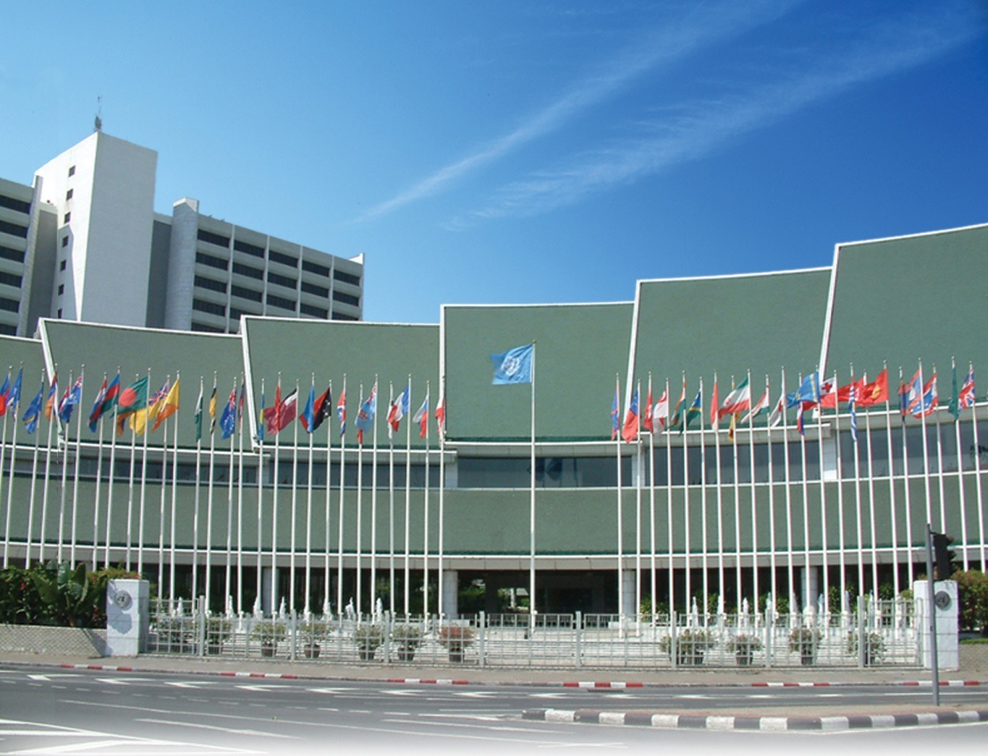
ESCAP: “Parliament” of Asia-Pacific
Notes:
Let me begin by sharing with you some ESCAP facts.
Established in 1947 with its headquarter in Bangkok, Thailand, ESCAP is the largest of the five United Nations regional commissions, and the highest-level, comprehensive intergovernmental forum in Asia-Pacific.
It serves as the “Parliament” of the region to address multi-sectoral development issues, such as: sustainable development; macroeconomic policy; trade and investment; transport; social development; environment; ICT; disaster risk reduction; statistics; and sub-regional activities for development.
The Social Development Division that I am heading is the focal division in charge of promoting the rights of persons with disabilities.

Slide 3
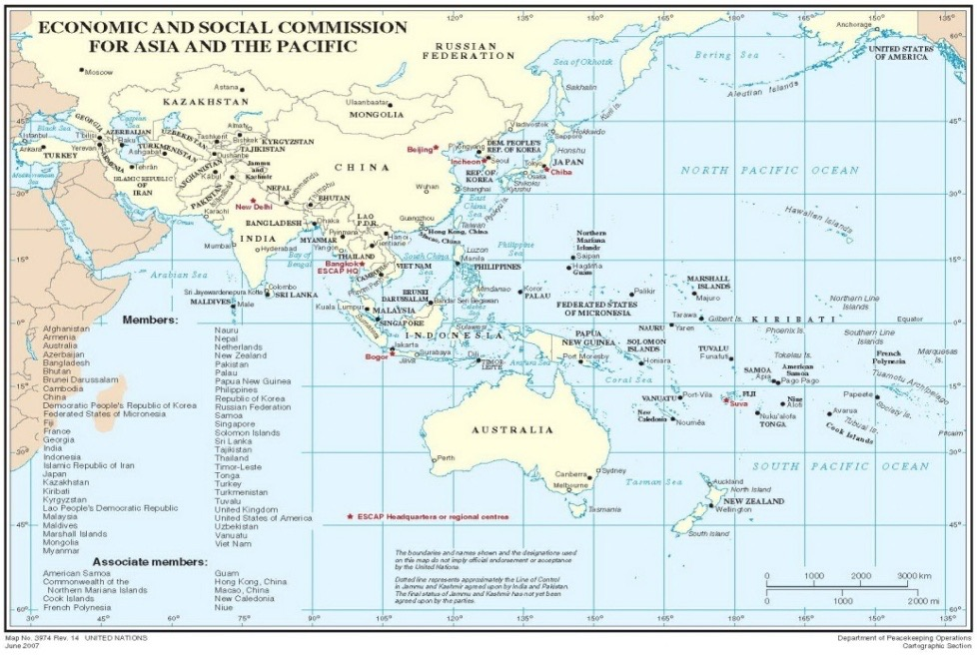
ESCAP Members: 62 Governments
Notes:
The ESCAP membership is made up of 62 member States, of which 58 are geographically in the region.
Its membership represents over two-thirds of humanity – from Moscow to Auckland, and from Ankara to Apia.
Clearly, what happens in the ESCAP region is of global significance.

Slide 4
Asian and Pacific Decades of Persons with Disabilities (1993-2002, 2003-2012, 2013-2022)
Global Asia-Pacific Africa West Asia
Years
1980
1990
2000
2010
2020
UN Decade of Disabled Persons, 1983-1992
Asian and Pacific Decade of Disabled Persons, 1993-2002
African Decade of Disabled Persons, 2000-2009
Asian and Pacific Decade of Disabled Persons, 2003-2012
Arab Decade of Disabled Persons, 2004-2013
African Decade of Persons with Disabilities,
2010-2019
2014
Asian and Pacific Decade of Persons with Disabilities, 2013-2022
Notes:
The ESCAP region led the world in proclaiming 2 consecutive regional Disability Decades from 1993 to 2012 to promote the long-term changes needed for making a difference in the lives of persons with disabilities.
African and Arab regions followed in the footsteps of our region and established their own regional initiatives.
Building on these first two regional Decades, Governments of the ESCAP region then proclaimed the period 2013 through 2022 the Asian and Pacific Decade of Persons with Disabilities.

Slide 5
National consultation in five countries in 2020
Assessment of the implementation of the Incheon
Strategy and the Beijing Action Plan

Slide 6
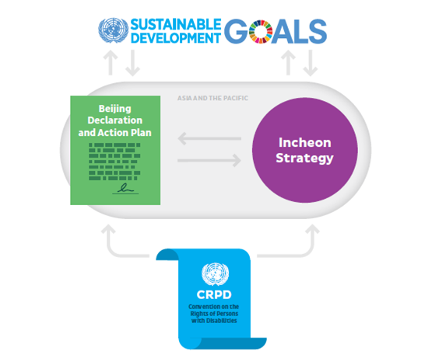
ESCAP approach:
Disability rights and disability-inclusive development (no one left behind, inclusive growth)

Slide 7
Working Group on the AP Decade
ASEAN Autism Network
Asia-Pacific Development Center on Disability (APCD)
Asia-Pacific Disability Forum (APDF)
Asia-Pacific Women with Disabilities United (APWWDU)
Asia-Pacific Disabled Peoples' Organizations United (AP DPO United)
Digital Accessible Information System (DAISY) Consortium
Disabled Peoples' International Asia-Pacific (DPI AP)
Inclusion International Asia-Pacific
Pacific Disability Forum (PDF)
Rehabilitation International Asia-Pacific (RIAP)
Shuchona Foundation
South Asian Disability Forum (SADF)
World Blind Union Asia-Pacific & Asian Blind Union (WBU-AP&ABU)
World Federation of the Deaf Regional Secretariat for Asia (WFD RSA)
World Network of Users and Survivors of Psychiatry (WNUSP)
Bangladesh
Bhutan
China
India
Indonesia
Japan
Kiribati
Malaysia
Myanmar
Pakistan
Republic of Korea
Russian Federation
Samoa
Thailand
Timor-Leste

Slide 8
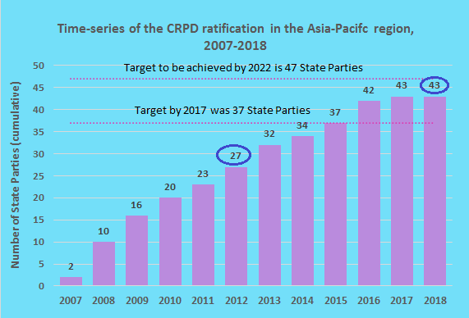
13 /43 reported on the existence of anti discrimination law on disability

Slide 9
Disability data capacity building project
Poor comparability of disability prevalence data due to differing concepts and measurements of disability

Slide 10
National consultation in five countries in 2020
On the implementation of the Incheon Strategy and the Beijing Action Plan
Regional meeting in September in Beijing

Slide 11
Working paper
Procurement policy as a tool to promote accessibility-due in mid 2019
Disability at a Glance: accessibility due at the end of this year
Disability-inclusive disaster risk reduction
  Due early 2020 followed by the regional workshop

Slide 12
Promotion of sign language as a language
Governments legal recognizing sign language
  ROK
  New Zealand
  Philippines
  Mongolia

Slide 13
Next Chair of the inter-agency support group on disability

Slide 14

Thank you!
< www.unescap.org/our-work/social-development >
<www.maketherightreal.net>
Notes:
14

