Slide 1
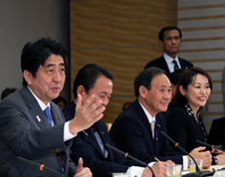

Annex ９
Promoting Active Participation
by Women
Minister of State for Gender Equality
Mori
Deputy PM &
Minister of Finance
Aso
Chief Cabinet Secretary Suga
PM Abe
Japan Revitalization Strategy – JAPAN is BACK –
Cabinet approval on June 14, 2013

Slide 2
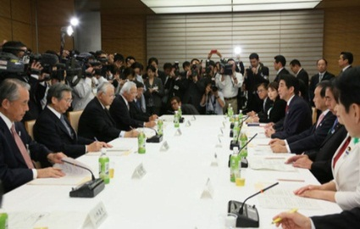
Creating women-friendly work environments and restoring vitality to society
Significance
Productive-age population continue to decline due to aging of the population and a falling birthrate
It is essential to secure talented human resources
regardｌess of gender to survive competition among companies including overseas companies
Goods related to daily life are highly demanded by women. However, few women hold significant decision- making positions in the companies and the organizations that provide such goods.
Increasing the workforce population
Discovering and securing talented women
Development of new markets from the perspective of livelihood.
Issues
To decrease the number of women quit their jobs because of child birth and child-rearing.
(60%of women quit their job s at the time of their first childbirth.)
For all listed companies to proactively appoint women to executive and managerial positions, first of all to appoint one female as an executive officer toward a target of “approximately 30% ratio of women in leadership positions by 2020. ”
To increase the proportion of women in leadership positions (The propotion of women in executive and managerial positions in companies is low.)
To create a workplace environment in which both men and women can, if they wish, easily take child care leave or shortened working hours until their child turns three.
Request to the Three Economic Associations
by Prime Minister Abe (April 19,2013)
Japan Revitalization Strategy –JAPAN is BACK – Cabinet approval on June 14, 2013
Governmental policies and measures
Granting incentives to companies that strive to support promotion of active participation by women
Supporting active participation by women according to the life stages of women
Creating an environment in which both men and women can strike a balance between work and child-rearing.
[Expansion of supports and honoring for companies ]
・to strengthen support by utilizing a subsidy system and tax measures for companies .
・to proceed with initiatives through public procurement .
・to improve a system that honors good practices .
[encouragement to increase appointment of women in executive and managerial positions ]
・to run campaigns to increase appointment of women in executive and managerial positions .
・to promote disclosure of information on appointment of women.
・ to create a database of female candidates for external executive , etc.
[ support for continued employment ]
・to create a system to subsidize companies that make efforts to improve the skills of employees who are on child care leave or return to work.
・to revise the level of child care leave benefits.
・to consider extending/enhancing the Act on Advancement of Measures to Support Raising Next –Generation Children.
・to encourage more men to actively take part in family chores and child-rearing.
[ support for reemployment]
・to provide programs that enable women to “relearn” skills at universities and other educational institutions .
・to support funding and management know-how for women who start new businesses.
[ creation of working environment, etc. ]
・to implement verification projects to establish new models to diffuse telework, that are not subject to constraints on place and time.
・to discuss comprehensibly about legislation on working hours from the point of view of work-life-balance and increase in labor productivity.
・to hold seminar on work –life balance for top managements of companies .
[ creation of a social base ]
・to develop “accelerating the zero childcare waiting list project”

Slide 3
[Reference 1] Women’s Labour Force Participation Rate by Age Group ( international comparison)
○In Japan, female labour participation rate by age group shows the so-called “M-shaped curve.”
The women’s labour force participation rate in Western countries no longer shows an M-shaped curve.
Japan
Japan’s current female labour participation rate by age group, shows the so-called “M-shaped curve,” that bottoms out in the 30s.
That indicates that many women still stop working at the time of marriage, childbirth, and child-rearing.
Germany
Korea
Sweden
United States
Women wishing to work
: 3.15 million persons.
(％)
15～19
(Notes)
“Labour force participation rate” = Proportion of labour force participation (Employed persons + Unemployed persons) in total population 15 years and over.
Japan:Data from “Labour Force Survey 2013 (Basic Tabulation), ” the ministry of Internal Affairs and Communications
Other Countries: Data from “ILOSTAT,” International Labour Organization
Data of Japan and United States are as of 2013, Data of other countries are as of 2012
Rate of those wishing to work and those waiting to start a new job to the population
Labour force:28.04 million persons.
Labour Force Participation Rate
○ However, women’s potential labour force participation rate, that add the women’s labour force participation rate
to the rate of women who wish to work, can be considered high.
(Of approximately 3.15 million people,
about 1.69 million are age 25 to 44.)
(Age)

Slide 4
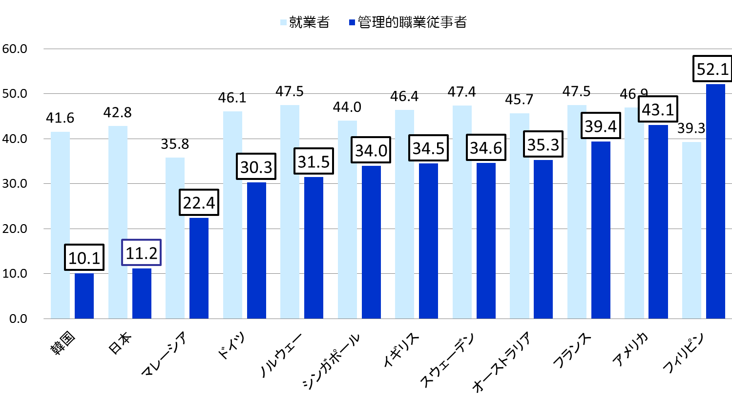
[Reference 2] The Proportion of Female Workers and Female Administrative/ Managerial Workers
(international comparison)
The proportion of female administrative and managerial workers is lower than that of female workers in comparison to other countries.
％
Workers
Administrative and Managerial Workers
Korea
Japan
United KIngdom
France
United States
Philippines
Malaysia
Germany
Norway
Singapore
Sweden
Australia
Notes
Data created from “Labour Force Survey” (Basic Tabulation) ,2013, by the Ministry of Internal Affairs and Communication and “Datebook of International Labour Statistics 2013, by the Japan Institute for Labour Policy and Training.
Data of Japan are as of 2013; data of other countries are as of 2011.
“Administrative and Managerial Workers” include company officers,company management staff, and management government officials among workers. Definition of administrative and managerial workers varies across countries.
Notes:
・Comparée à celle des autres pays, la proportion des femmes dans l'ensemble des travailleurs japonais n'est pas spécialement forte, mais la proportion de femmes dans les postes d'encadrement est faible, similaire à celle de la Corée du Sud.

Slide 5

Granting incentives, etc. to businesses that strive to
support promotion of women’s participation
Encourage to promote more women to management positions
Achieve “30% by 2020 target” to promote women in leadership positions
GOV
Co.
Incentives
● subsidy
● Tax system
● Public procurement
Award good practices
Strengthen to balance work and child-rearing such as taking child care leave and short-time working
Dissemination of women’s promotion in listed companies
Disclosure of women’s promotion
Dissemination of good practices
evaluation
Stakeholders
Investors
consumers
Students in Job-hunting

