Slide 1
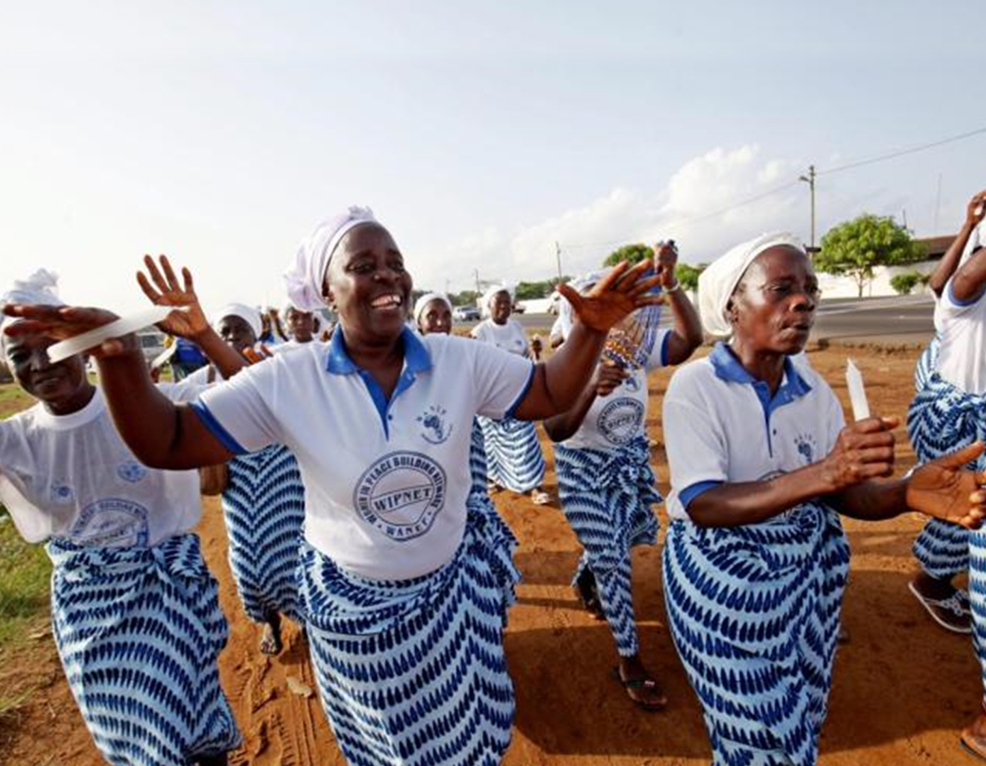


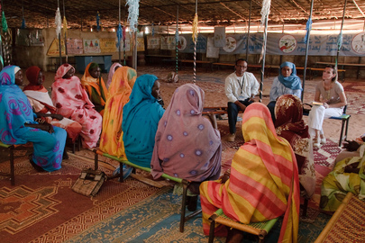
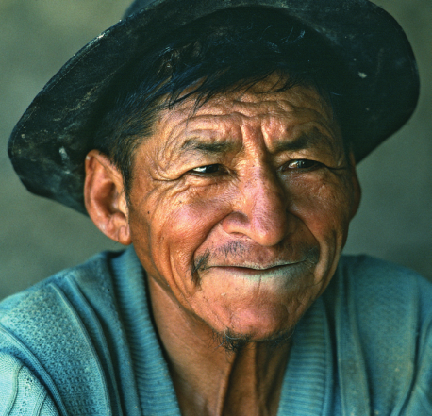
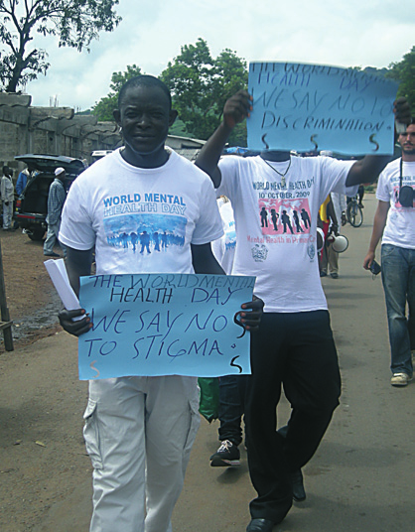

WHO QualityRights
Transforming services and promoting rights in mental health
Michelle Funk
WHO Mental Health Policy
& Service Development

Slide 2
WHO QualityRights
Objectives
Build capacity to understand and promote human rights in mental health
Create community based services and supports that respect and promote human rights
Improve the quality and human rights conditions in mental health and related services
Support the development of a civil society movement to conduct advocacy and influence policy-making
Reform national policies and legislation in line with the CRPD and other international human rights standards
Notes:
2

Slide 3







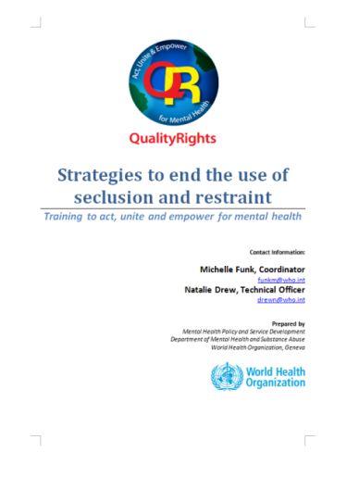


Face-to-face training modules
Build capacity on rights & develop skills to put them into practice

Slide 4

Guidance and face-to-face training modules
Core mental health and human rights modules:
Understanding human rights
Promoting human rights in mental health
Improving the mental health and related service environments and community inclusion
Realising recovery and the right to health in mental health and related services
Protecting the right to legal capacity in mental health and related services
Creating mental health and related services free from coercion, violence and abuse
Specialised modules:
Realising supported decision making and advance planning
Promoting recovery in mental health and related services
Implementing strategies to end the use of seclusion and restraints and other coercive practices

Slide 5

QualityRights e-training
Foundation in Mental Health, Human Rights & Recovery
Expert coaches & mentors
Peer-to-peer learning & sharing
Reaching, engaging & training thousands of people within & across countries

Slide 6
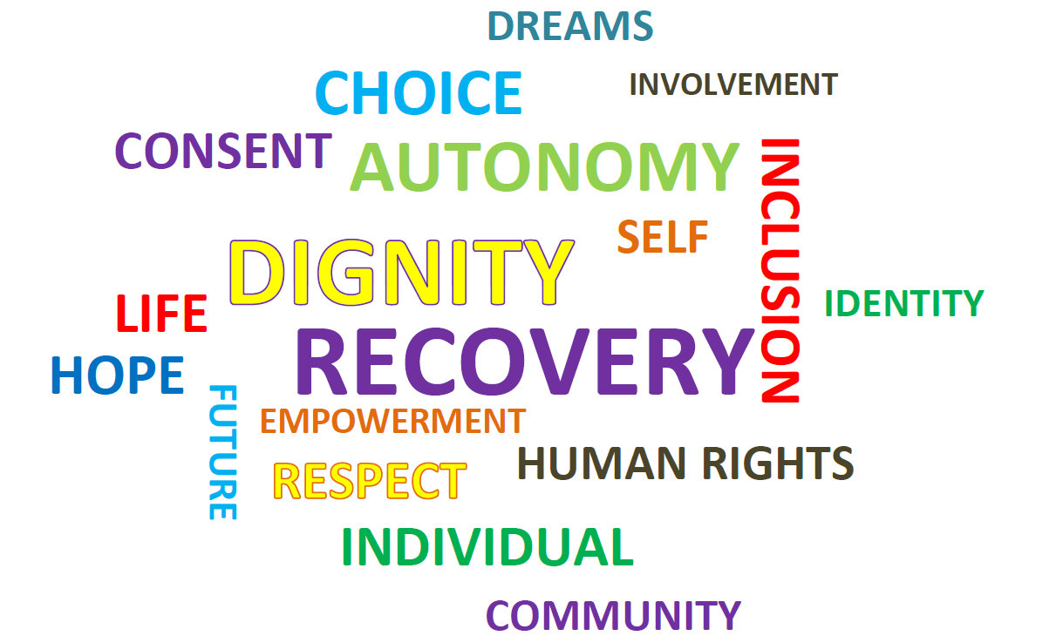
Guidance: Good, promising & emerging services & supports
Services & supports that:
Operate without coercion
Respond to people’s needs
Support recovery
Promote autonomy & inclusion
Evaluation of services & supports:
Costs
Outcomes
Sustainability
Transferability

Slide 7
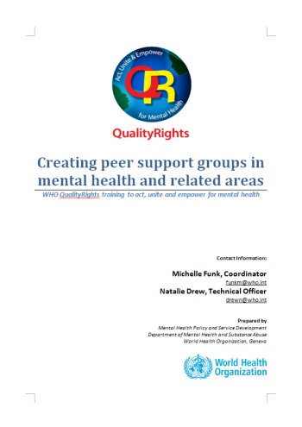
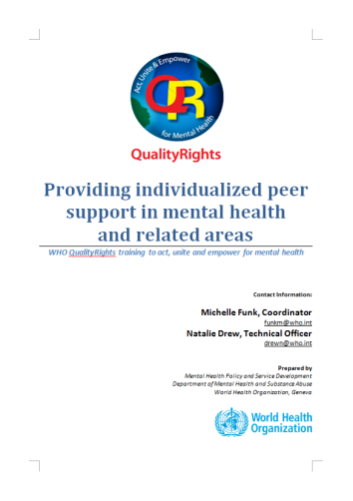
Guidance on peer supports & services
  Providing individualised peer support within services and the community
  Setting up and running peer support groups

Slide 8


Assessing & improving quality and rights in services
  Assessment toolkit
New!
  Guidance - Improving & transforming services

Slide 9


Guidance on civil society and advocacy
  Setting up and operating a civil society organization
  Conducting advocacy campaigns to integrate human rights in mental health
Notes:
9

Slide 10

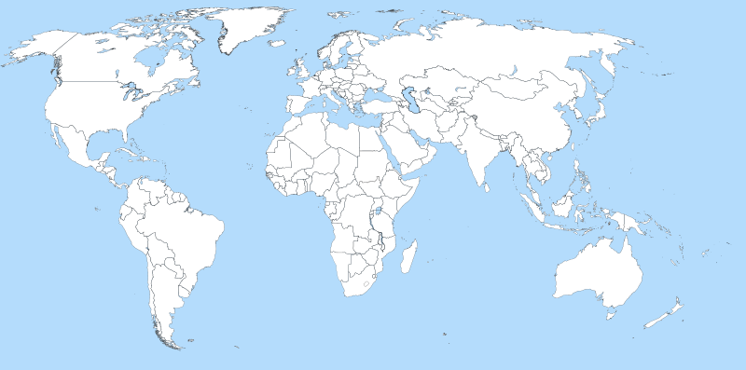
Implementation in countries
Albania
Lithuania
Latvia
WHO EURO –
25 countries
Spain/Asturias
Italy
Greece
Croatia
Spain/Valencia
Bosnia
Bulgaria
Lebanon
mhLAP countries (Nigeria, Ghana, Sierra Leone, Liberia, Gambia)
Occupied Palestinian Territories
Tunisia
Afghanistan
Jamaica
Gujarat/India
Malaysia
Somaliland Region of Somalia
Burkina Faso
Pacific Island countries
Fiji and Tonga, Samoa, Vanuatu and Solomon
Brazil
Chile
Western Australia
Countries/States which have already implemented QualityRights
Countries/States currently implementing QualityRights
Countries/States planning to implement QualityRights

Slide 11

QualityRights Gujarat
Results
Important improvements in quality & human rights in services:
Physical and social environment
Comprehensive & holistic approach emphasizing recovery & addressing mental and physical health care needs across the life course
informed consent, respect for autonomy, supported decision making
Reduced use of violence, coercion & abuse
Linking people to community based services
Major shifts in attitudes concerning coercion
Reduced stigma
Greater empowerment of people using the services
Activities
QR assessment
Service change plans
Training on human rights and recovery
Peer support workers
Peer support groups

Slide 12
Thank you!

