Slide 1

Legal Aid South Africa
Response to questions on the Country Report
12 October 2021

Slide 2

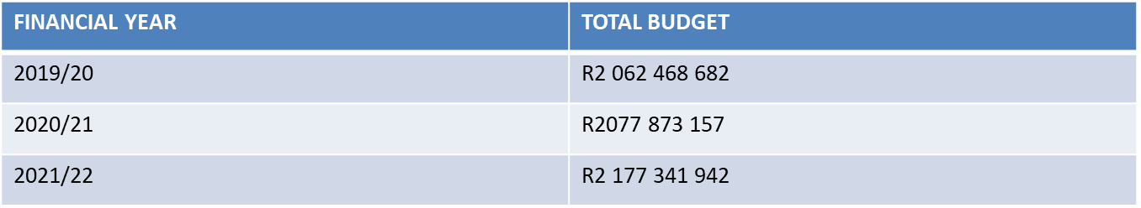
LEGAL AID SOUTH AFRICA BUDGET
Total budget cut over the MTEF period 2021/22 – 2023/24 of R534,670 million. This will result in a reduction in the coverage of courts and delivery of legal aid services to indigent and vulnerable persons, affecting the ability of Legal Aid SA to fulfil its mandate.
The reduction in budget will result in a reduction in service delivery staff;
The criminal court coverage will reduce, access to Legal Aid services will be available, however the turnaround time of criminal cases will be affected;
Access to Civil Legal Aid Services ( Family Law, Socio Economic Rights, etc.) will have to be reduced
Legal Aid SA Annual Performance Report 2020-2021
16

Slide 3

2. Performance FY 2020-2021
Financial Performance
Legal Aid SA has received its 20th unqualified audit opinion
33%
92%
Decrease in irregular expenditure incurred
Budget spent
97.7%
≥80% of budget spent on direct legal service delivery
Trade creditors paid within 30 days
1
Legal Aid SA Annual Performance Report 2020-2021

Slide 4
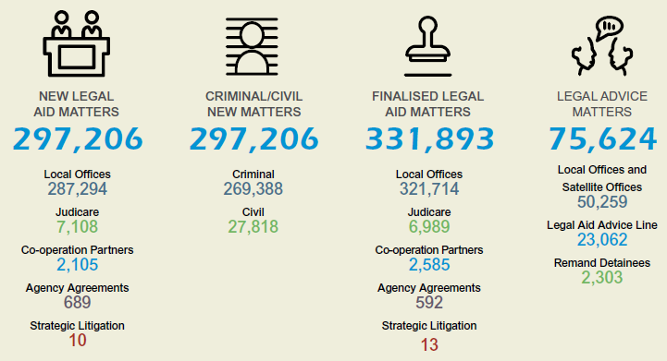
2. Performance FY 2020-2021
372,830
Legal Service Delivery
Indigent and vulnerable people provided with legal representation & legal advice
Legal Aid SA Annual Performance Report 2020-2021

Slide 5
3. Criminal/Civil Split by gender
372,830
Gender | Civil |  | Criminal |  | Total
 | Number of Applications | % | Number of Applications | % | Number of Applications | %
Female | 16 585 | 57% | 21 435 | 7% | 38 020 | 11%
Male | 12 642 | 43% | 295 811 | 93% | 308 453 | 89%
Total | 29 227 |  | 317 246 |  | 346 473
Legal Aid SA Annual Performance Report 2020-2021

Slide 6
6. Legal Service Delivery: Criminal Cases
90% of legal Aid SA’s court work is criminal in nature
Guideline 9 of the UN Principles and Guidelines on the implementation of the right of women to access legal aid provides that: States should take applicable and appropriate measures to ensure the right of women to access legal aid
In adherence to guideline 17, Legal Aid SA has embarked on gender sensitive training to all Legal Aid Employees during 2021
Women in South Africa is recognised as a vulnerable group. Women who become perpetrators of crime, have in most cases been exposed to some sort of abuse – whether physical, emotional or psychological.
Our Criminal Law currently are gender neutral and makes no provision for the vulnerability of the female accused person during arrest, trial and sentencing. All legal aid SA practitioners are sensitised to the vulnerability of women in conflict with the law though our various business plan programmes
Legal Aid SA is rolling out a pilot project to ensure early contact after arrest, however this was delayed due to the Covid 19 pandemic
Legal Aid SA Annual Performance Report 2020-2021
9

Slide 7

NGIYABONGA
THANK YOU
KE A LEBOGA DANKIE

Slide 8
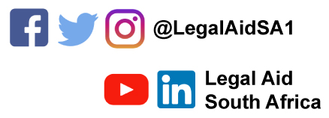
Follow us on social media
www.legal-aid.co.za

